Slide 1
Managing Infrastructure/Neighborhood Improvement Projects Presented by City of Idaho Falls, Idaho

Slide 2
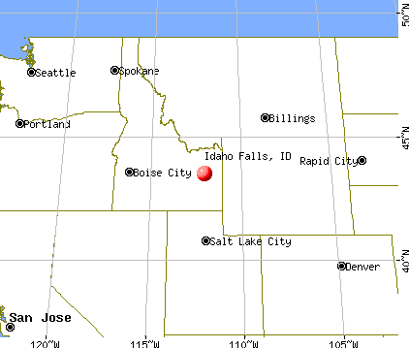
City of Idaho Falls Profile
Settled in 1865 (then called Eagle Rock)
Incorporated in 1891
Population 64,818
Metropolitan Planning Area (MPA)
123,964 Idaho Falls, Bonneville County,
Cities of Ammon, Ucon and Iona
5th largest city in Idaho
Low (80%) Income Limits (family of 4)
$68,300 Bonneville County
2023 CDBG Annual Allocation $433,830
City of Idaho Falls, Idaho
Notes:
CDBG-CV allocation: $507,657 (CV1/CV3)
Additional CARES Act/ American Rescue Plan funding:
No additional CARES Act.
ARPA $10.5 million.

Slide 3
How Projects are Chosen
Need identified through public participation
Need/Priority in development of 5-Year Plan
HUD National Objective
HUD Eligible Activity
HUD Priority (1 of 4)
Council Approved
Notes:
Needs identified through a comprehensive citizen participation process in the development of the current Five-Year Consolidated Plan.
Meets Housing & Urban criteria.
Projects/activities selected are Council approved as part of the Annual Action Plan

Slide 4
HUD Criteria of Projects/Activities
Must meet 1 of 3 National Objectives (HUD)
Benefit LMI
Prevent/Eliminate conditions of SBA
Meets Urgent Needs
Must be a HUD Eligible Activity
Construction of Public Infrastructure
Handicapped Access/Public Facilities
Housing Rehab, Acquisition, Clearance/Disposition
Economic Development
Additional Criteria
Meets goals of current Five-Year Consolidated Plan
Council approved for the Annual Action Plan
Notes:
CDBG Basics - HUD criteria and examples of activities

Slide 5
HUD Definitions - Four Priorities
Community Development Priority
Neighborhood revitalization, promotes public health/safety.
Economic Development Priority
Improve economic conditions principally for LMI persons.
Housing Development Priority
Encourages development of new, affordable single, multi-family, and special needs housing through private developers and non-profits.
Public Service Priority
Encourages partnerships with social service providers, faith-based groups, non-profit agencies, and community leaders to address LMI needs.
Notes:
CDBG Basics - HUD defined priorities

Slide 6
(3) Census Tracts for Projects
Notes:
HUD Income guidelines released each year by State/County

Slide 7
Working Effectively with other Departments
Managing the project
Project Scope (PS) - Who is developing it?
Public Works/City Engineer, Architect, Drafter (all/some?)
PS drives Environmental Review (ER)
ER good for 5 years
ER allows you to address one street at a time.
Realistic timeline/expectations - when can it really start?
Working with Departments (Public Works Division)
On-going - Educate staff on use of CDBG funds
Davis Bacon Wage/Certification, Procurement, Invoicing
DB Cert - Due end of work week by contractor/subs
Coordinate with Public Works.
Notes:
Have input of the Project Scope as it will drive the ER for up to 5 years.
If project scope changes along the way, the ER changes.
On-going working relationship with Public Works or the Department.
Don’t submit for reimbursement without accurate signed/dated DB Certifications.

Slide 8
Curb, Gutter, and Sidewalk Projects Public Infrastructure/LMI Area Neighborhoods
Pros
Provides needed infrastructure
Located in LMI census tract
LMI rental properties
Direct benefit - 51% or > LMI benefit
Addresses ADA issues
Cons
Property owners live outside area/state
Owner enforcement difficult
LMI renter feels the burden
Notes:
Fund the activity not the entity
Direct LMI benefit (70% or more required)

Slide 9
Procurement Process
HUD required docs to be included in bid packets
Project Scope with funding source/grant number
Federal Labor Standards Provisions - HUD Fm 4010
Davis Bacon Wage Rate/job classification by construction type
Best Practices
Bid packet - Public Works - copy for your file
Pre-construction meeting - Educate staff /contractors
DB Weekly Certification (U.S. Dept. of Labor Wage/Hour Div.)
Project before pictures - Public Works
Notice to start - Public Works issues - copy for your file
Project after pictures - Public Works
Notes:
Provide inserts for bid packets to Public Works before they go out
Be on the agenda to educate staff and contractors
Get before/after pictures if Public works cannot

Slide 10
Managing Infrastructure and Neighborhood Improvement Projects
Tools to assist in the process
Cooperative Agreement (City/Public Works)
Sample Bid Packets (public works projects)
Sample Bid Packets (non-public works projects)
Approval Checklist - CDBG Projects/Activities
Before/after pics
HUD sign pics
Best Practices
Walking tour of completed projects
Bring a city interpreter
Interview residents that benefitted from the project (likes/dislikes)
Share feedback with Public Works
Include feedback/input in the CAPER
Notes:
Tools provided at the link on last slide/page
Use check box to ensure all is completed before considering invoices

Slide 11
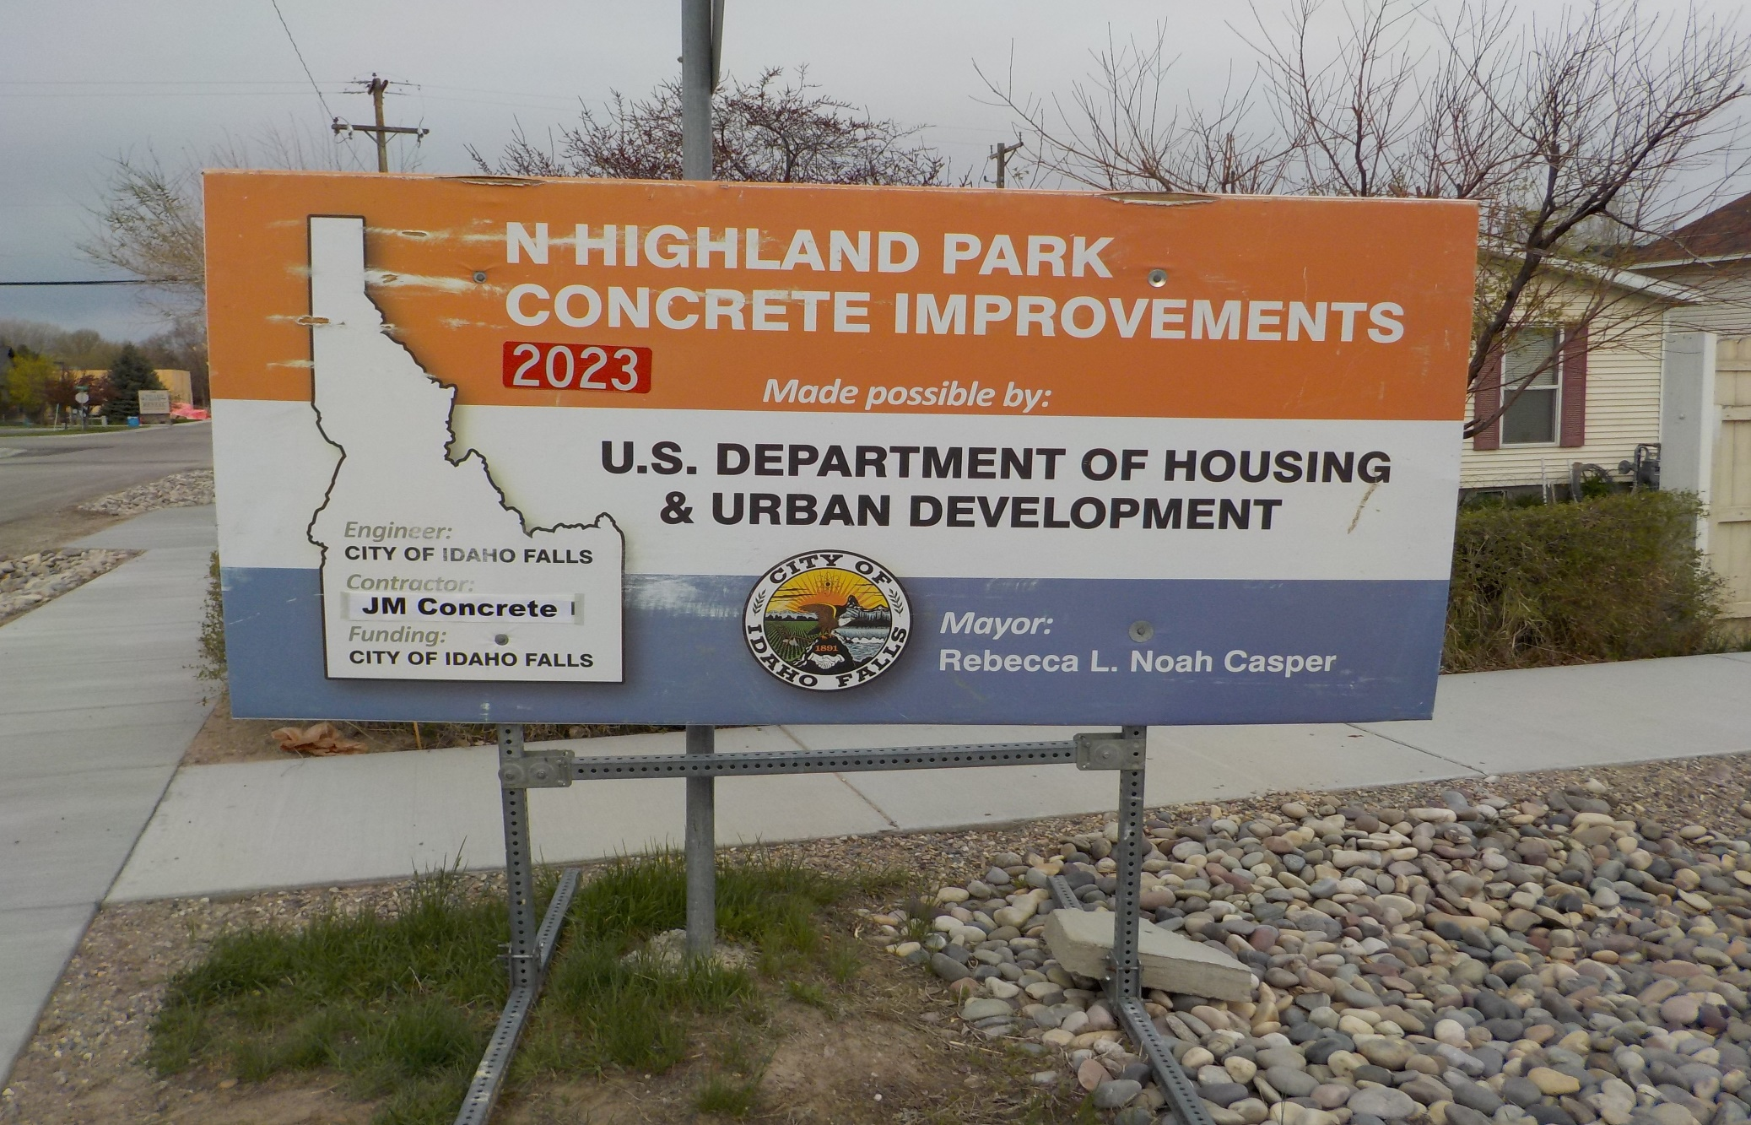
HUD Sign at Project Site
Notes:
Not a requirement, however,; is a great way to let neighborhood know what project is being completed in their neighborhood.

Slide 12
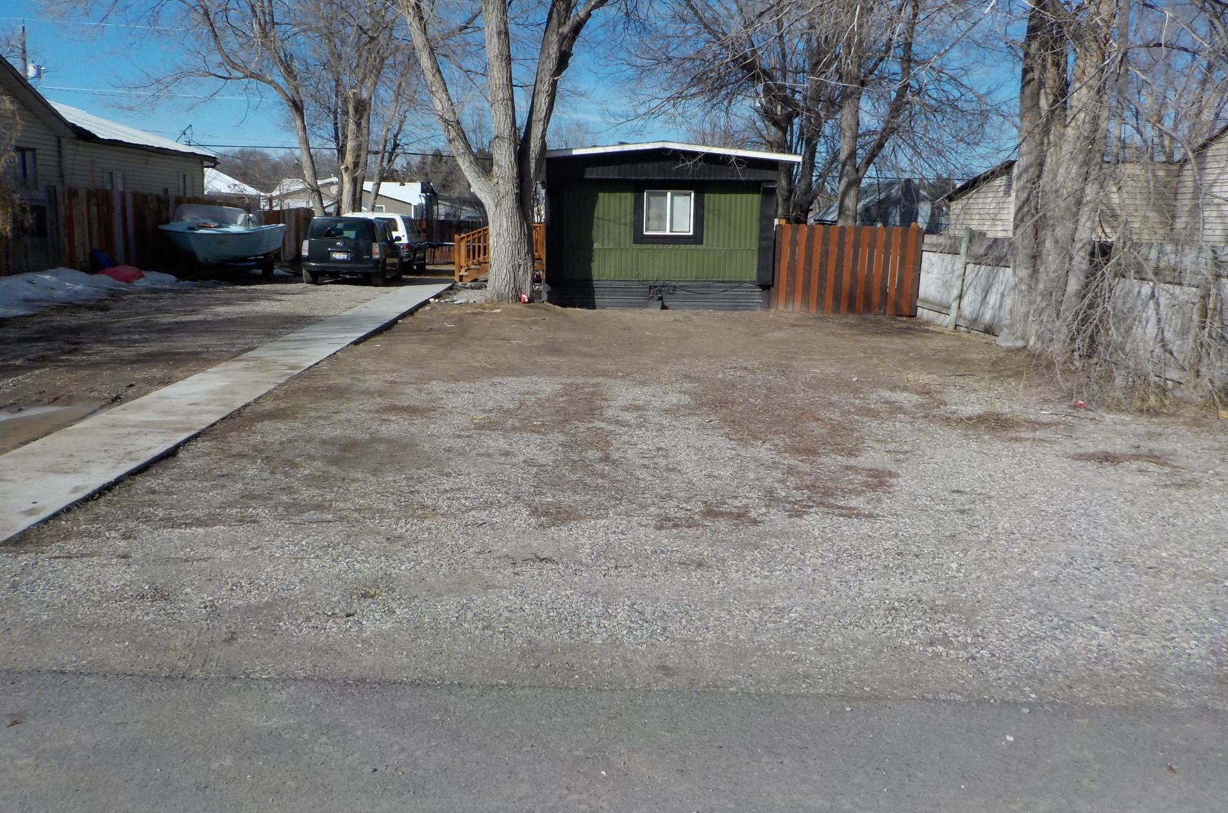
Community Development Public Infrastructure Before

Slide 13
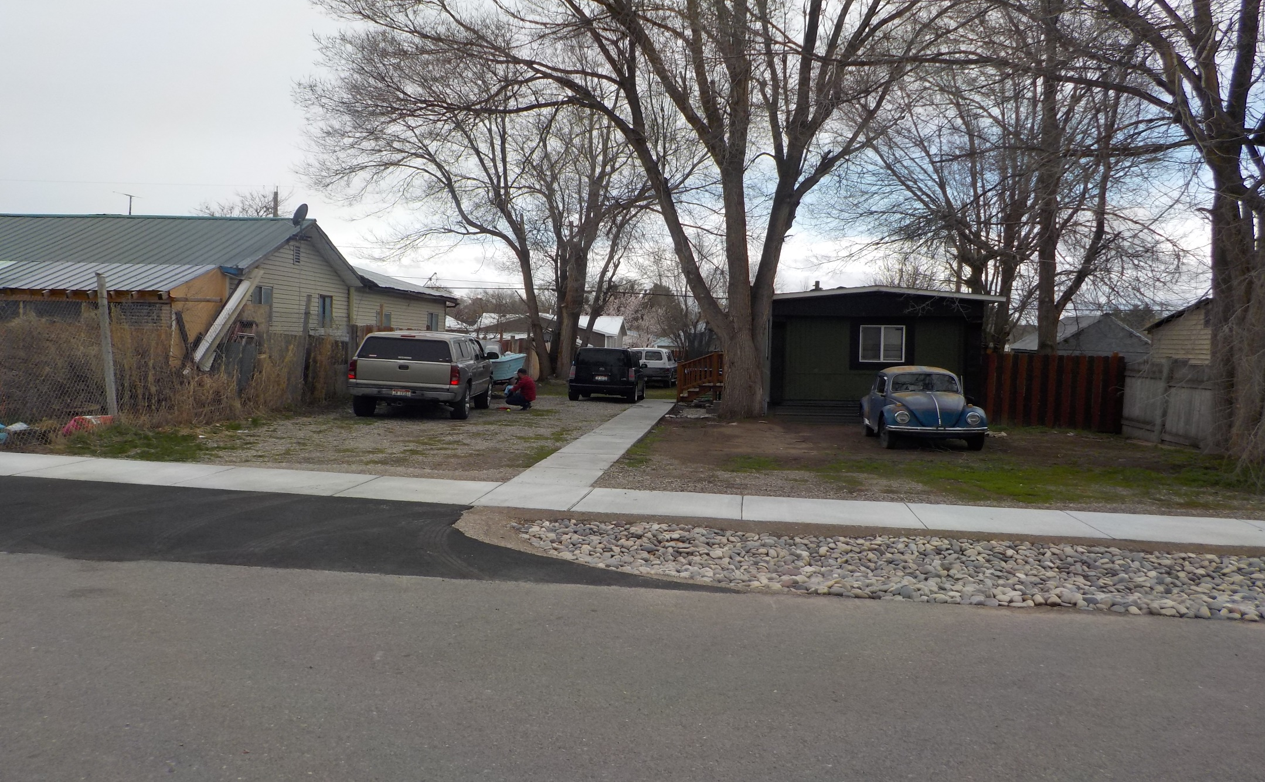
Community Development Public Infrastructure After

Slide 14
Community Development Public Infrastructure Before

Slide 15
Community Development Public Infrastructure After

Slide 16
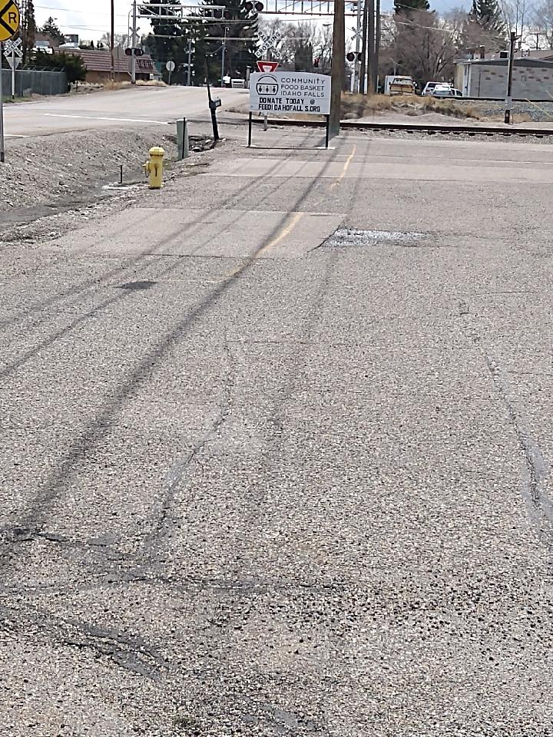
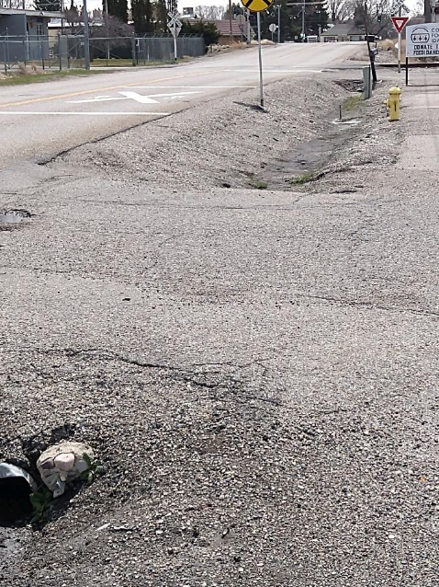
Non-Public Works Project - CV3-CDBG Community Food Bank Idaho Falls - Warehouse Parking Rehab
Notes:
Example of project completed that is not an improvement to a public facility.
Followed a similar procurement pre-bid process.

Slide 17
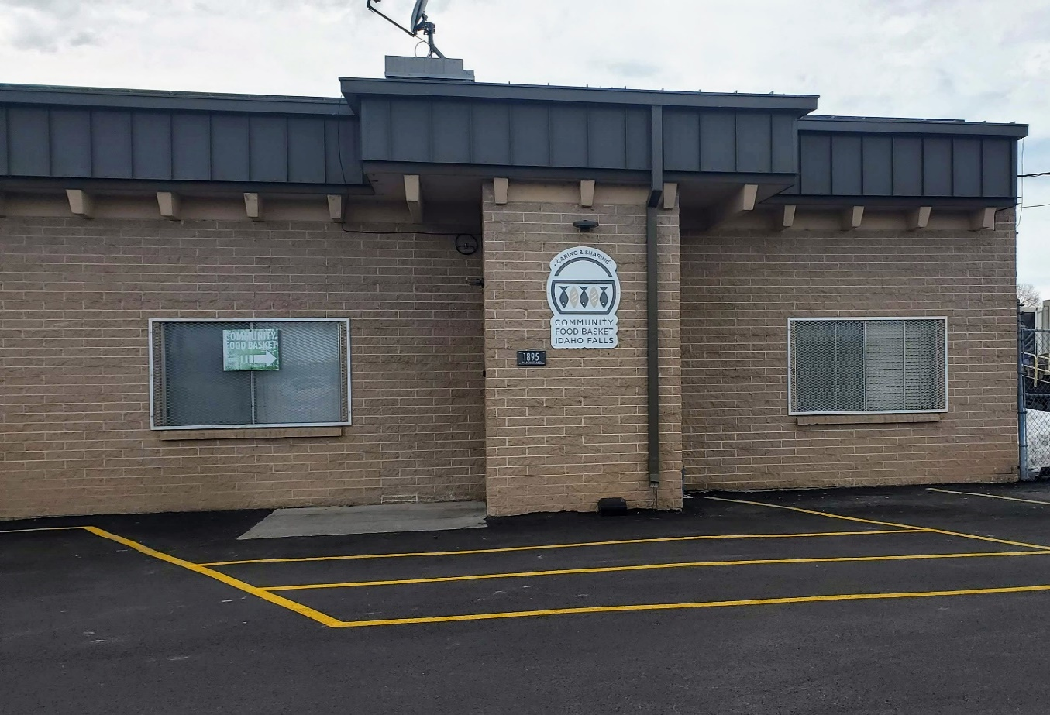
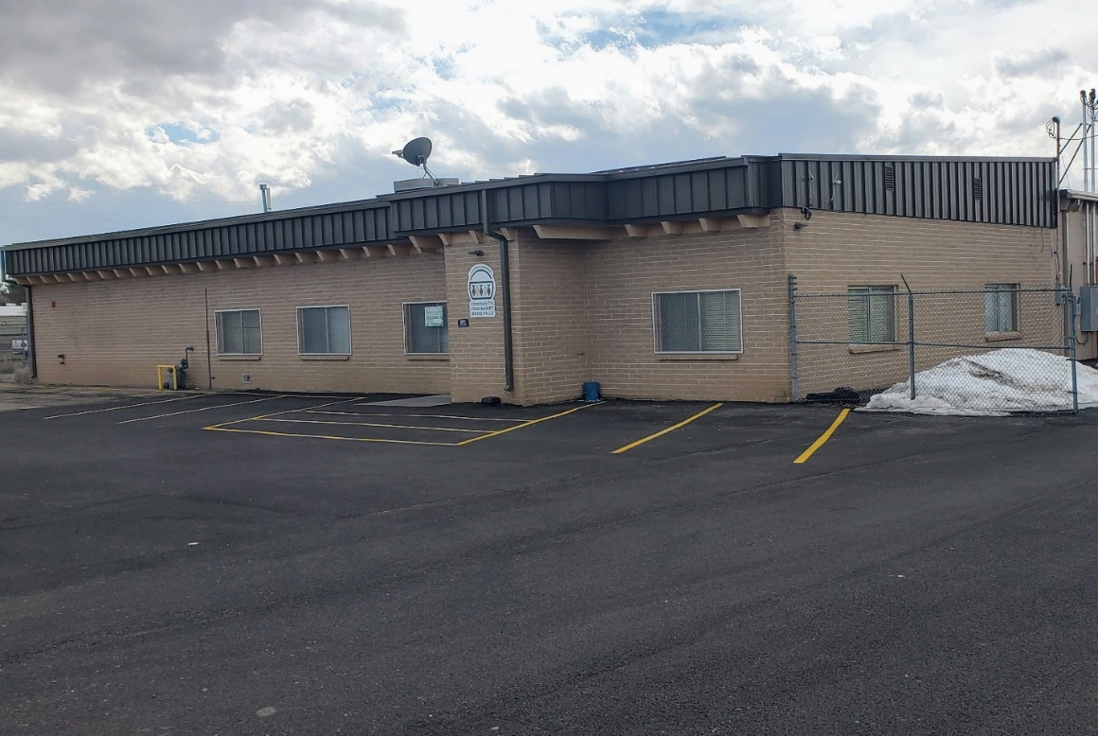
After Community Food Bank Warehouse Parking Rehab Project

Slide 18
Comments or Questions
Lisa Farris, Grants Administrator LFarris@idahofalls.gov
Link for a copy of presentation, tools, and docs found at
Insert LINK ADDRESS HERE
Visit City/CDBG website for Plans, docs, pictures at
www.idahofallsidaho.gov
To access: Click on Government, Department, Community Development Services, Planning, and then Community Development Block Grant
Notes:
Follow the link address for copies of slides, tools, and resources discussed on slide #9

